Slide 1




CHAPTER 4
USING PYTHON LIBRARIES

Slide 2
Introduction
  Python has a large collection of pre-written code that we can directly use.
  These collections are stored in the form of modules, libraries, and packages.
  Instead of writing code from scratch, programmers can use existing code to:
    Save time
    Reduce errors
    Improve program readability

Slide 3
What is a Library?
  A library in Python is a collection of pre-written modules that contain useful functions, classes, and variables.
  These libraries help programmers perform common tasks without writing code from scratch.
  In simple words, a library provides ready-made code that we can reuse in our programs to make development faster, easier, and more efficient.
  Python comes with a standard library containing many built-in modules.

Slide 4
Commonly used Python Libraries:
Python provides many libraries that contain predefined modules and functions to perform specific tasks such as mathematical calculations, scientific computing, GUI creation, and data visualization.
  Python Standard Library : The Python Standard Library is a collection of built-in modules that are available with Python installation. These modules do not need to be installed separately.
    Examples of Python Standard library Modules:
    maths, cmath, random, statistics , Urllib module.

Slide 5
  NumPy Library : NumPy (Numerical Python) is a library used for numerical and mathematical computations. It is mainly used for working with arrays and matrices.
  SciPy Library : SciPy (Scientific Python) is built on top of NumPy and is used for advanced scientific and technical computing.
  Matplotlib Library : Matplotlib is a library used for data visualization. It helps in plotting graphs and charts such as line graphs, bar charts, and pie charts.

Slide 6
What is a Module?
  A module is a single file containing Python code (.py file).
  It may include functions, variables, classes, constants.
  Examples : math.py, random.py, string.py.
  Its contents can be reused in other programs, without having to rewrite them.
  Example Understanding:
    If a library = a book
    Then a module = one chapter in that book.

Slide 7
Structure of Python Module
  A Python module is generally divided into the following parts:
    Documentation String (Docstring) : It is written at the beginning of the module to explain the purpose of the module. It is written inside triple quotes.
    Import Statements : It is used to import other modules and libraries. Placed after docstring.
      Example : import math
    Global Variables (Optional) : Variables defined at the module level. These are accessible throughout the module.
      Example : PI = 3.14

Slide 8
    Function Definitions : Contains functions that perform specific tasks. Improves code reusability.
      Example: def area_circle(r):
return PI * r * r
    Class Definitions (Optional) : Used for object-oriented programming.
      Example: class Circle:
def __init__(self, radius):
self.radius = radius
    Executable Statements / Main Code : Code that runs when the module is executed directly. Often written using
    if __name__ == "__main__"

Slide 9
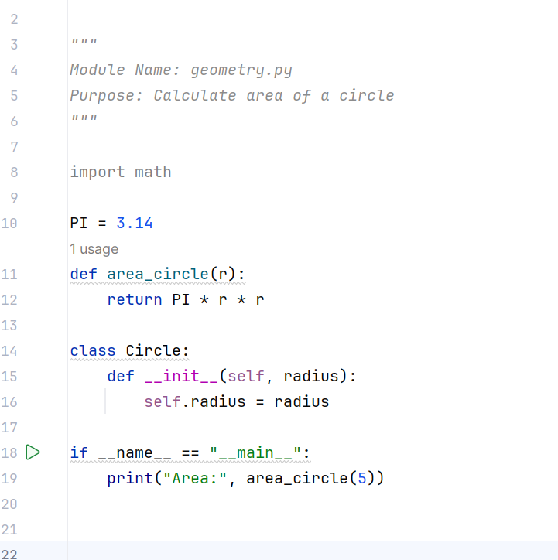
Complete Example of a Python Module
docstring
import statement
global variable
Functions
Main code

Slide 10
Importing Modules in a Python Program
    Python provides multiple ways to import modules.
  Importing Entire Module:
    import module_name
  Importing Select Objects from a Module:
    from module import objectname
    Import Single Object:
      from math import pi
    Import Multiple Objects:
      from math import sqrt, pow
    Import all objects of a module:
      from module import *

Slide 11
Python’s Processing of Import Module Command
  When a module is imported in a Python program, Python performs a fixed sequence of steps to make the module and its contents available for use.
Namespace :
  A namespace is a mapping of names to objects. It helps Python identify which name refers to which object and avoids name conflicts.
  Types of Namespaces
    Built-in namespace – contains built-in functions like print(), len()

Slide 12
    Global namespace – names defined in the current program
    Module namespace – names defined inside a module.
      Example : import math
print(math.pi)
  Namespaces avoid confusion between same variable/function names and help prevent name conflicts.
Processing of import module Command
  When Python encounters an import module statement, it:
    Searches for the module:
      In the current directory
      In Python’s standard library directories

Slide 13
    Loads the module:
      Executes all statements present in the module once.
    Creates a module namespace:
      All variables, functions, and classes of the module are stored here
    Creates a reference name:
      The module name becomes a reference to the module namespace
    Accessing members:
      Members must be accessed using dot operator (.)
  Example: import math
print(math.sqrt(16))

Slide 14
Processing of from module import object Command
  from module_name import object_name
  When this statement is executed, Python:
    Searches and loads the module (if not already loaded)
  Copies the specified object
    The object is copied directly into the current namespace
  No module name is created
    Only the imported object is available
  Example: from math import sqrt
print(sqrt(25))
    math.sqrt() is not required
    math namespace is not created

Slide 15
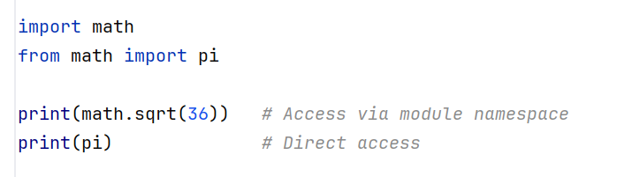
Example
  math → module namespace
  pi → directly imported into current namespace

Slide 16
Python Built-in Mathematical Functions
Function | Purpose | Syntax | Example | Output
len() | Returns number of elements | len(obj) | len("Python") | 6
pow() | Returns x raised to power y | pow(x, y) | pow(2, 3) | 8
str() | Converts value to string | str(value) | str(10) | '10'
int() | Converts value to integer | int(value) | int(12.9) | 12
float() | Converts value to float | float(value) | float(5) | 5
range() | Generates sequence of numbers | range(start, stop, step) | range(1, 5) | 1 2 3 4
type() | Returns data type | type(obj) | type(3.5)
abs() | Returns absolute value | abs(num) | abs(-9) | 9
divmod() | Returns quotient & remainder | divmod(a, b) | divmod(17, 5) | (3, 2)
sum(iterable) | Sum of elements | sum(iter) | sum([1,2,3]) | 6
sum(iterable, arg) | Sum + starting value | sum(iter, start) | sum([1,2], 10) | 13
max(iterable) | Largest element | max(iter) | max([4,9,2]) | 9
max(arg1, arg2, …) | Largest value | max(a, b, c) | max(3,7,5) | 7
min(iterable) | Smallest element | min(iter) | min([4,9,2]) | 2
min(arg1, arg2, …) | Smallest value | min(a, b, c) | min(3,7,5) | 3
oct() | Converts to octal | oct(int) | oct(10) | 0o12
hex() | Converts to hexadecimal | hex(int) | hex(15) | 0xf

Slide 17
Python Built-in String Functions
Function | Purpose | Example | Output
join() | Joins sequence into string | " ".join(["Hi","All"]) | Hi All
split() | Splits string into list | "Hi All".split() | ['Hi','All']
replace() | Replaces substring | "cat".replace("c","b") | bat

Slide 18
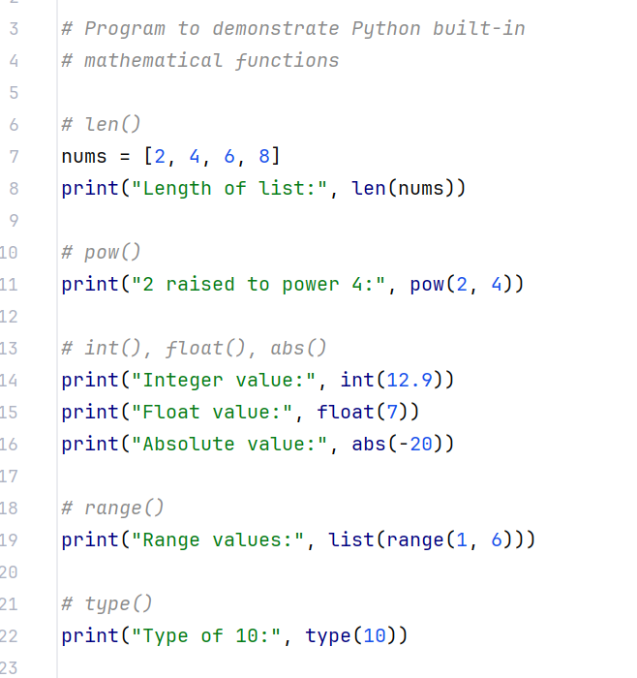
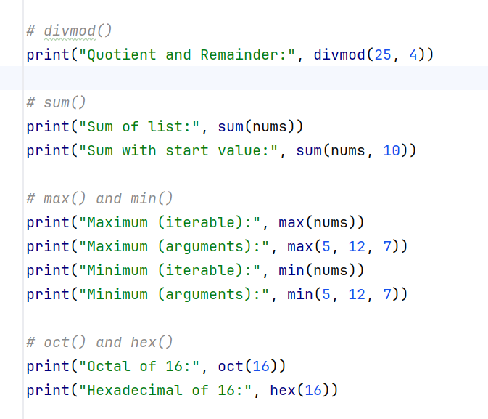
Python Program Using Mathematical Built-in Functions

Slide 19
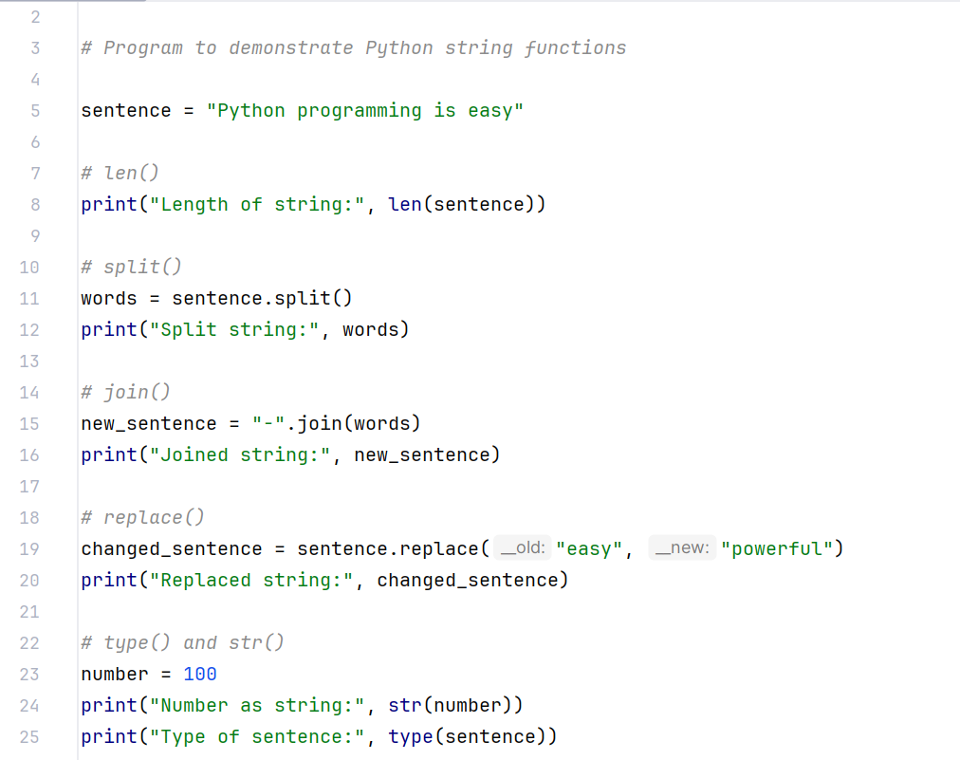
Python Program Using String Functions

Slide 20
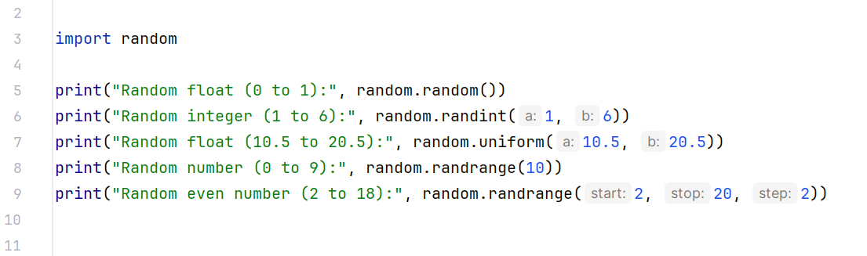
Working with Some Standard Library Modulus
  Using Random Module:
  The random module is a part of Python’s Standard Library.
  It is used to generate random numbers.
  To use the random module, we must first import it.
    import random

Slide 21
Random Module Functions
Function | Purpose | Syntax | Example Code | Output
random.random() | Generates a random floating-point number between 0.0 and 1.0 | random.random() | random.random() | 0.63
random.randint(a, b) | Returns a random integer between a and b (inclusive) | random.randint(a, b) | random.randint(1, 10) | 7
random.uniform(a, b) | Returns a random floating-point number between a and b | random.uniform(a, b) | random.uniform(1.5, 5.5) | 3.84
random.randrange(stop) | Returns a random integer from 0 to (stop − 1) | random.randrange(stop) | random.randrange(10) | 6
random.randrange(start, stop[, step]) | Returns a random integer from given range with optional step | random.randrange(start, stop, step) | random.randrange(2, 20, 2) | 14

Slide 22
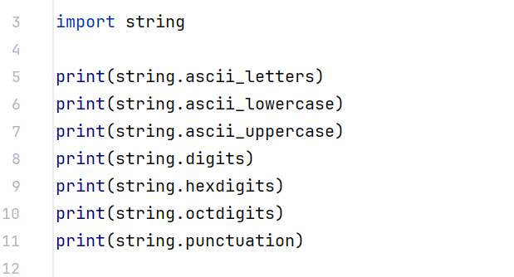
  Using String Module:
  The string module is a part of Python’s Standard Library.
  It provides useful string constants such as letters, digits, and symbols.
  To use the string module, we must first import it.
    import string

Slide 23
String Module Constants with Output
Constant | Purpose | Output
string.ascii_letters | Contains all English letters | abcdefghijklmnopqrstuvwxyzABCDEFGHIJKLMNOPQRSTUVWXYZ
string.ascii_lowercase | Contains lowercase letters | abcdefghijklmnopqrstuvwxyz
string.ascii_uppercase | Contains uppercase letters | ABCDEFGHIJKLMNOPQRSTUVWXYZ
string.digits | Contains decimal digits | 123456789
string.hexdigits | Contains hexadecimal digits | 0123456789abcdefABCDEF
string.octdigits | Contains octal digits | 123456
string.punctuation | Contains punctuation symbols | !"#$%&'()*+,-./:;<=>?@[\]^_{

Slide 24
Creating a Python Library
  In Python, a library is a collection of modules, and a package is a collection of related modules arranged in a directory structure.
Structure of a Python Package
  A package is a folder (directory) that contains Python modules and a special file named __init__.py.
  mypackage/
  │
  ├── __init__.py
  ├── module1.py
  ├── module2.py

Slide 25
Procedure for Creating a Python Package
Step 1: Create a Folder
  Create a directory that will act as the package.
    mathlib
Step 2: Create __init__.py
  Inside the folder, create a file named:
    __init__.py
Step 3: Create Module Files
  Create one or more .py files inside the package.

Slide 26
  Example: operations.py
def add(a, b):
return a + b
def sub(a, b):
return a - b
Final Package Structure:
mathlib/
│
├── __init__.py
├── operations.py

Slide 27
Using / Importing Python Libraries (Packages)
Once the package is created, it can be used in a Python program using import statements.
Method 1: Import Entire Module
import mathlib.operations
print(mathlib.operations.add(5, 3))
Method 2: Import Specific Function
from mathlib.operations import add
print(add(10, 4))

Slide 28
Method 3: Import Module with Alias
import mathlib.operations as op
print(op.sub(8, 2))
  A package is a directory
  __init__.py is mandatory to define a package
  A library = collection of packages/modules
  Packages help in better organization and reusability

Slide 29
Conclusion
  In this chapter, we learned about Python libraries and modules, which provide predefined functions, classes, and constants to perform common programming tasks efficiently.
  We studied the concept of modules, packages, and namespaces, and understood how Python processes different import statements.
  The chapter also covered the use of Python’s Standard Library, including built-in mathematical functions, string functions, and commonly used modules such as random and string.
  Finally, we learned how to create our own Python libraries using packages, which helps in organizing, reusing, and maintaining code.
  Overall, Python libraries make programming simpler, faster, and more structured, enabling the development of reliable and efficient programs.

